Slide 1
Learning X
Jianhong Mou
Neil Hinrichs
Patrick Hill
Sarah Inman
Tianyu Luo

Slide 2
CHALLENGE:
How might we create an adaptive learning experience for Java Programming coursework?
Notes:
Our design challenge

Slide 3
Project Description
There is a need for deeper learning in many higher education courses. We are designing and developing a web-based platform for adaptive learning to engage students metacognitively and socio-cognitively. We will test with Stevens students and faculty.

Slide 4
Measurement for Engagement
We seek to measure how attracted users are to the system. As a component of engagement, we seek to measure depth of learning and retention with material.
We intend to measure engagement and depth of learning by exploring how much time a user spends on a task. We also seek to perform a knowledge assessment pre and post the “intervention”. We will administer a survey to participants post-intervention to gauge how satisfied they were with the design of the system.
We intend to use Google Analytics to measure bounce rate (how long someone stays on a page before leaving), and what pages are the most popular. We would also like to perform a wireframe analysis to see how they navigate through the site and which areas on the page are clicked most which Google Analytics also supplies us with. By seeing which pages they engage with most and least we will be able to assess the usability of particular elements. We can also log how many times/how often they log in.

Slide 5
Industry & Academic Research
Learning Management System usage is predicted to grow by about 23% in the next few years (Docebo, 2014). Despite this progress, reported use of assessments is far lower; according to user research, 26% of people are dissatisfied or very dissatisfied with their current LMS (Medved, 2015). Given that an LMS is designed to augment teaching and learning, why is the use of the assessment engine so low?
Zimmerman & Schunk (2011) conclude that online learning depends on “self regulated learning, a form of learning which the learner is primarily responsible for initiating, managing, and sustaining the learning process.” Self-regulated learning is related to metacognition, or the reflection on one’s cognitive process (Nelson & Narens, 1990). Metacognition has been studied widely in educational contexts (Grotzer & Mittlefeldt, 2012; Bjork et. Al., 2013) and can be outlined as the interplay between monitoring, or assessing one’s own knowledge, and control, or managing cognitive processes with other cognitive processes (Nelson & Narens, 1990). Kuh (2009) defines engagement in this way: “the engagement premise is straightforward and easily understood: the more students study a subject, the more they know about it, and the more students practice and get feedback from faculty and staff members on their writing and collaborative problem solving, the deeper they come to understand what they are learning” (p. 5).

Slide 6
Target Population
Our target population is an introductory course at Stevens Institute of Technology. Our target users would be first year undergraduates pursuing a Computer Science, Cybersecurity, Information Systems, or Quantitative Finance major. There may be some engineering majors who take this course as well as an elective. Our users will be students just starting college; we would like to avoid testing in an advanced class as we think our study would benefit from a larger pool of users. We propose Intro to Java, such as CS 501 or EE 810, as a good option, and will be contacting the professors this week. We could also potentially try CS 115 – Intro to Comp Sci. Brian Borowski teaches CS 115 this semester, and Peter Jurkat teaches CS 501. Jurkat’s course is online and has minimal opportunities for engagement, so this could be a great target course for us. Dov Kruger teaches EE 810 and would be willing to let us test. We would also like to observe users to build an experience map.
Notes:
In this slide, you can see our target population. Our primary tests were Java Programming students in both Computer Science and Electrical and Computer Engineering. We initially designed for the student; however, we also found instructor input very useful and ended up designing a teacher portal as well.

Slide 7


Persona
Our fictional user, Sam, is motivated to learn more deeply because he feels he needs to make up for an insufficient educational experience from high school. Although he wants to take Java to learn more about Computer Science and game design, he feels like he has too much to learn. He knows he’ll be good in Computer Science because he likes goal-based games.
His older sister has always been the star of the family, because she knew how to be good in school given the traditional, linear educational model. Sam is a bit younger and more creative, but he has a short attention span and has never found school very engaging. When Sam heard about this adaptive learning platform, he became excited to test it out.
Sam spends most of his time with his girlfriend, Sarah. Sarah plays music and dropped out of college last semester.
He is heavily influenced by his girlfriend because she’s so cool. They take lots of trips together (for her concerts) so he’s rarely at his desk.
The professor of this course is another important persona. S/he wants to engage with students in a non-traditional way.

Slide 8

Evaluator Persona
Emma is an expert in computer science, but she is not formally trained in design. She is an instructor at Stevens Institute of Technology where she seeks to do better in her teaching; however, she is
under the stress of the institution to publish more research. She is also teaching four courses and was just promoted from Adjunct to Assistant Professor. Her heroes are Katherine Johnson and Charles Lyell.
Notes:
We also created a persona for our evaluator. For user testing, we sought instructors of Java but also students. We also recruited highly technical support staff who could speak to the ease of use and functionality of the site.

Slide 9
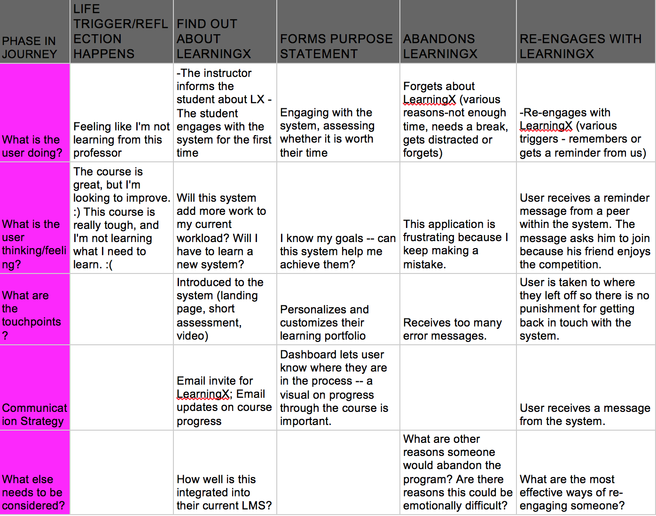
Notes:
Here is the experience map for our target user. Not all cells are filled because we did not think we need a communication strategy for the life triggering moment. The communication strategy for abandons LX and re-engages with LX is the same. We would send a message from the system to remind the user to update their progress.

Slide 10
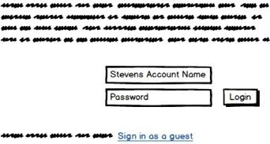
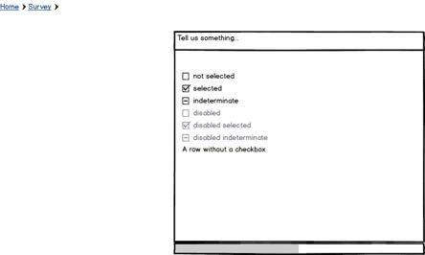
Low Fidelity Prototype
For low-fidelity prototyping, we used Balsamiq. We used google docs as our collaborative space. This has been our medium for sharing documents and working on the project asynchronously. We also use Skype and https://appear.in/experience for synchronous group meetings.
If the user selects student, they will be given a pop up screen. This prompt will ask a few questions to gauge where the user is in their learning process. There is also a progress bar at the bottom of the survey. This is where we want to learn more about our user's goals for learning java.
This is our login page to have people access their own account. The user's account will hold onto the users progress in their questions / learning modules. Alternatively they can sign in as a guest and not have information saved.
Notes:
Here are some pages from our low-fidelity prototype. For this prototype, we used Balsamiq.

Slide 11
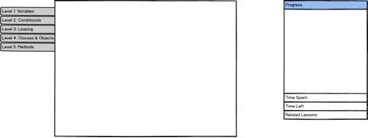
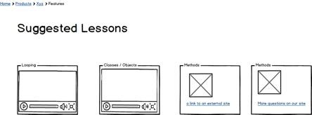
Low Fidelity Prototype
Here is the Explore user experience. After finishing the content a user will be directed here. This is where they can get access to other sources of knowledge. These four are the options of additional content.
Here is the traditional user view. In the center box will be our main content. As of right now questions will exist there and will transition to suggested lessons and potentially games to play about the topics.
Notes:
Low fidelity prototype continued..

Slide 12
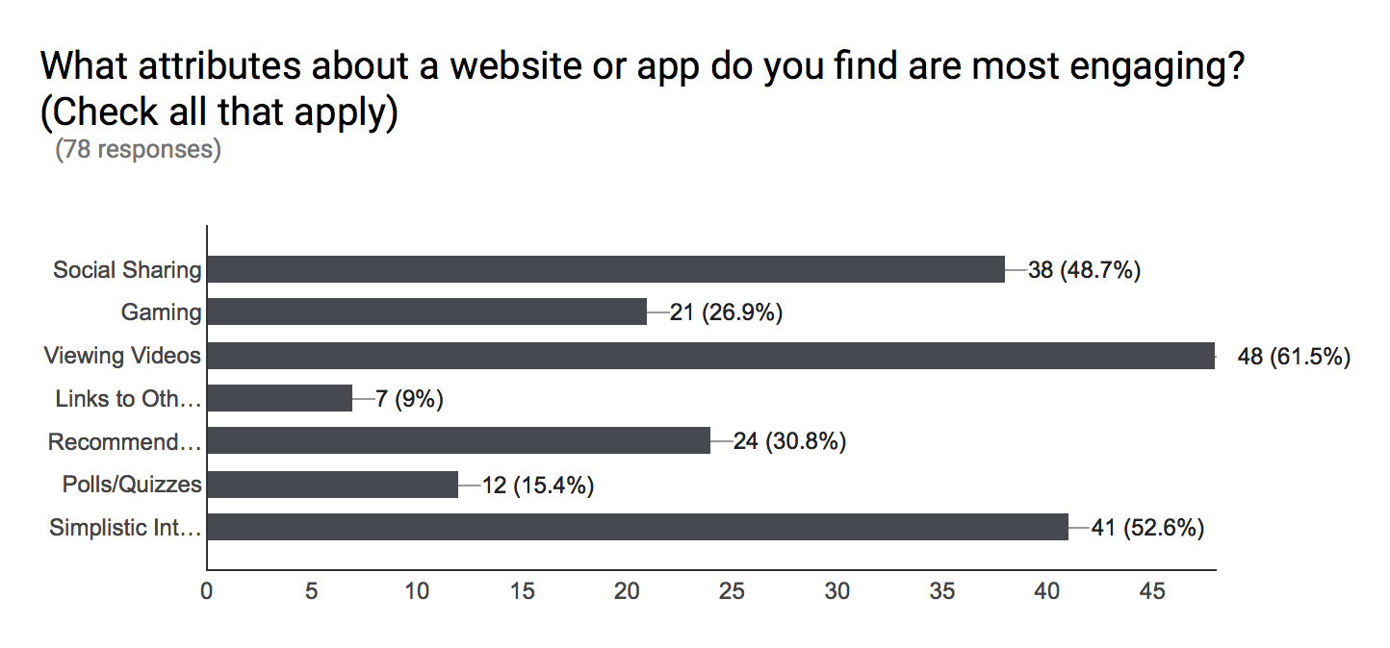
Survey Data
N = 78 in our first survey; testers were Stevens students in Introduction to Java Programming courses
Notes:
Originally, we thought that adding more text to explain the problems would be the best route; however, our survey showed that students learn better from videos. As such, we incorporated more video and less text into our system interface.

Slide 13

Our survey on student engagement showed that the majority (62%) thought viewing videos was the most engaging attribute. 53% said that a simplistic interface is critical. And 49% voted that social sharing was another critical component to engagement. Contrary to common practice, quizzing and gaming scored lowest.
Notes:
In this slide, you can see a summary of some of the salient findings from the survey.

Slide 14
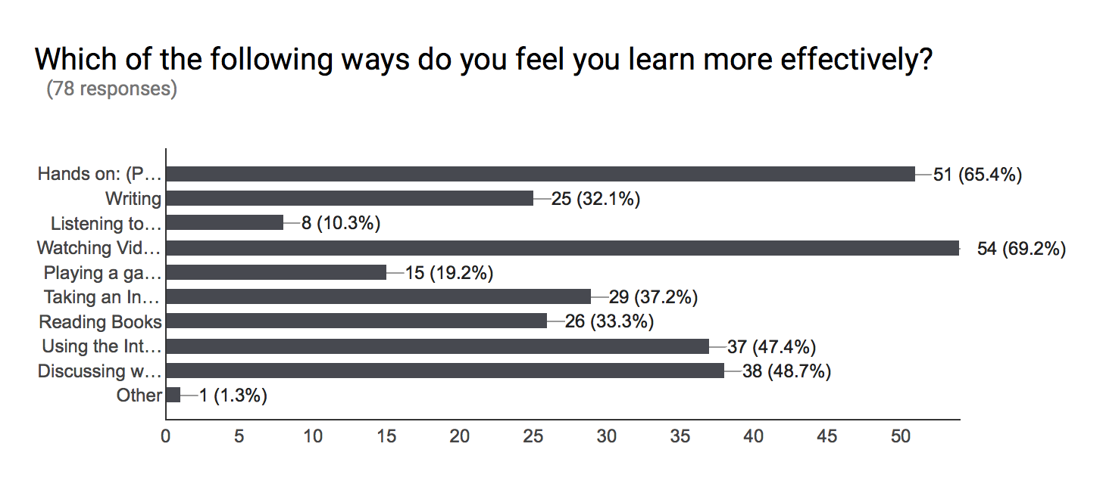
Notes:
We found that over half of the participants felt that learning hands-on or project-based (65.4%) and watching a video (69.2%) were two ways that users learned more effectively. According to this survey, the least effective learning methods were playing a game (19.2%), listening to a podcast (10.3%), writing (32.1%), and reading books (33.3%). We found the results somewhat surprising considering the data the supports gamification of learning as well as the balance between reading, writing, and listening. If redesigning the survey, we would add additional parameters such as “listening to a podcast alongside visuals” or “playing a game with your peers”.

Slide 15
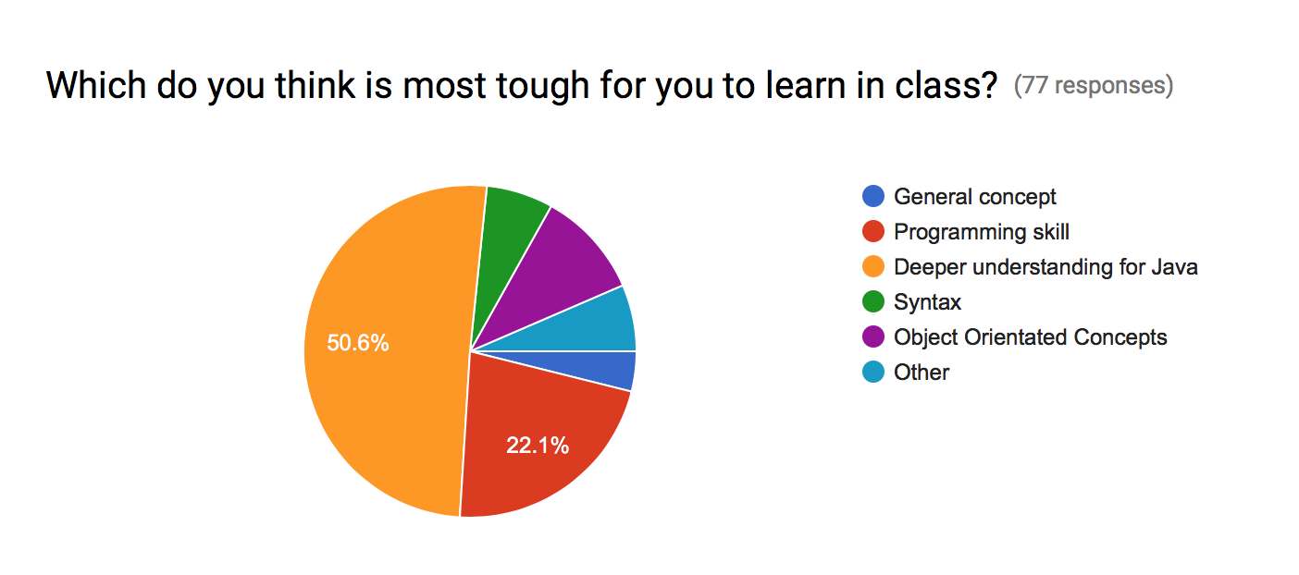
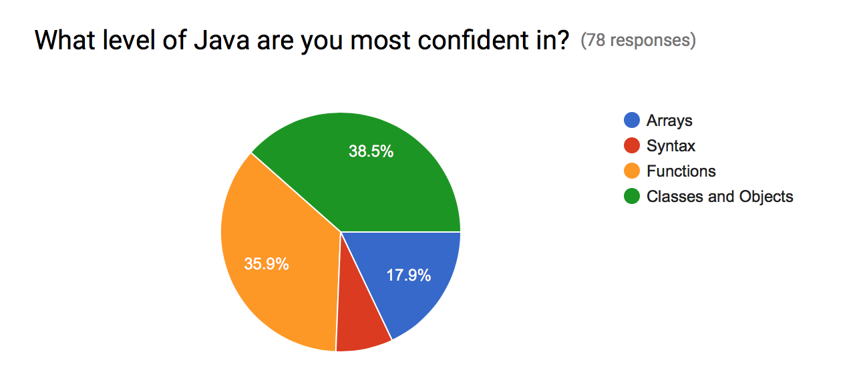
Notes:
This data influenced what topics we focused on in our prototype. The survey showed that a little over half felt an overall deeper understanding of java was most difficult to learn in class; however, the majority are least confident in syntax. Therefore, we provided a range of topics that we feel holistically covers Java, focusing on syntax as one main component.

Slide 16
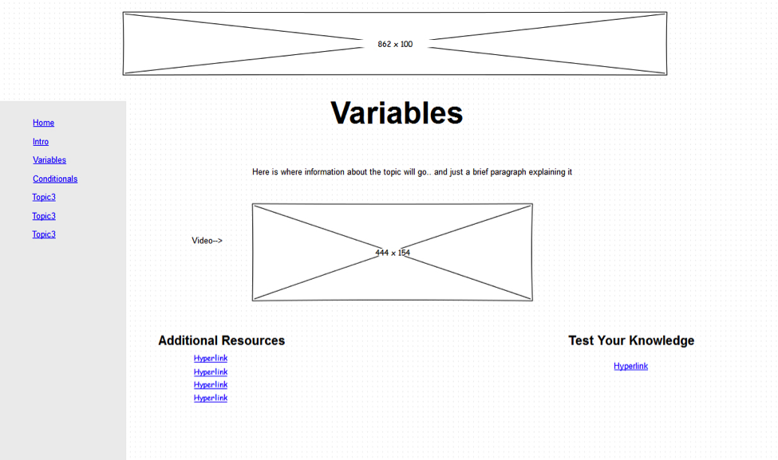
Medium Fidelity Prototype
[1]
Logo part, we show our logo here.
Slide navigation part. It shows different topics, user settings and entrance to quiz.
Video part. It displayed a tutorial video of current topic. This embedded video may from youtube or vimeo.
Resources part. It provides additional resources to current topic.
Quiz part. In this part, users can test their how well they learn. This is also topic-related.
[1] We made the prototype by Pencil.
Notes:
In this slide, you can see our medium fidelity prototype, which we created using Pencil. Please see descriptions in the slide.

Slide 17
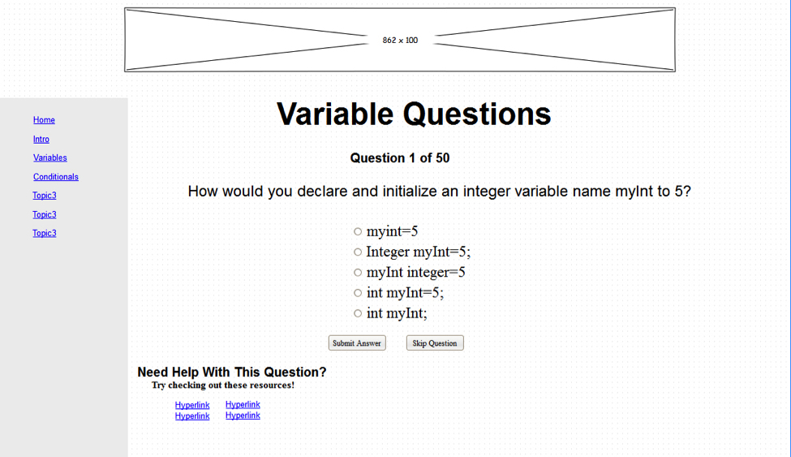
Medium Fidelity Prototype
Logo part, we show our logo here.
Slide navigation part. It shows different topics, user settings and entrance to quiz.
Question part. This displays a question each time and it shows your progress above. Meanwhile, you can select answers or skip the question.
Suggestion part. It provides resource related to current question. When users stucked, this may be helpful.
Notes:
Medium fidelity prototype continued

Slide 18
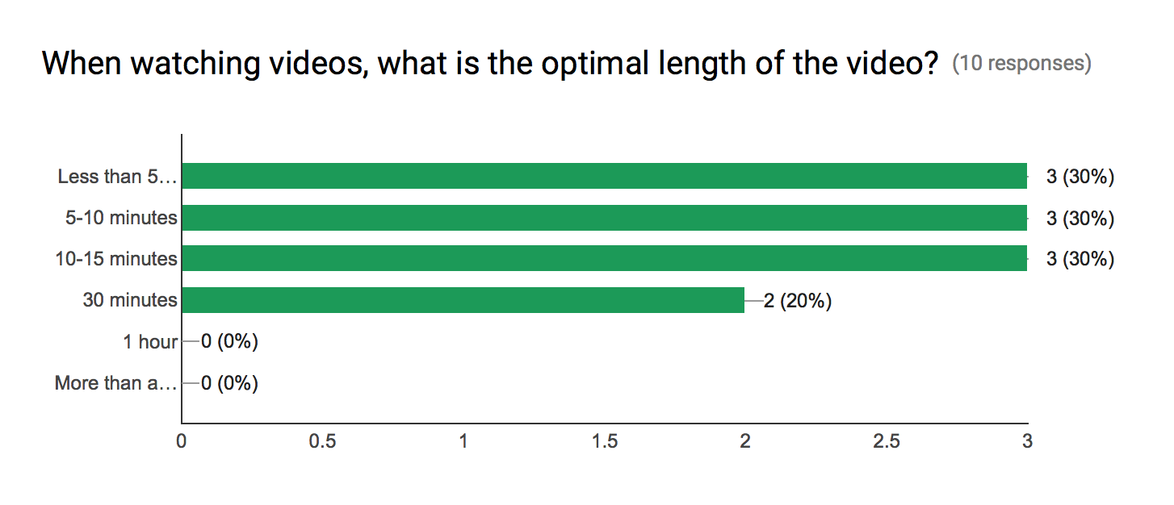
Survey Data
n= 10 in our second survey of Stevens students.
Notes:
Our second survey wasn’t quite as popular as our first. We only had 10 participants; however, we received some great feedback. As expected, the majority of users said that videos under 15 minutes were optimal. Only 20% voted for videos that are 30 minutes. And zero participants voted for 1 hour or more than an hour.

Slide 19
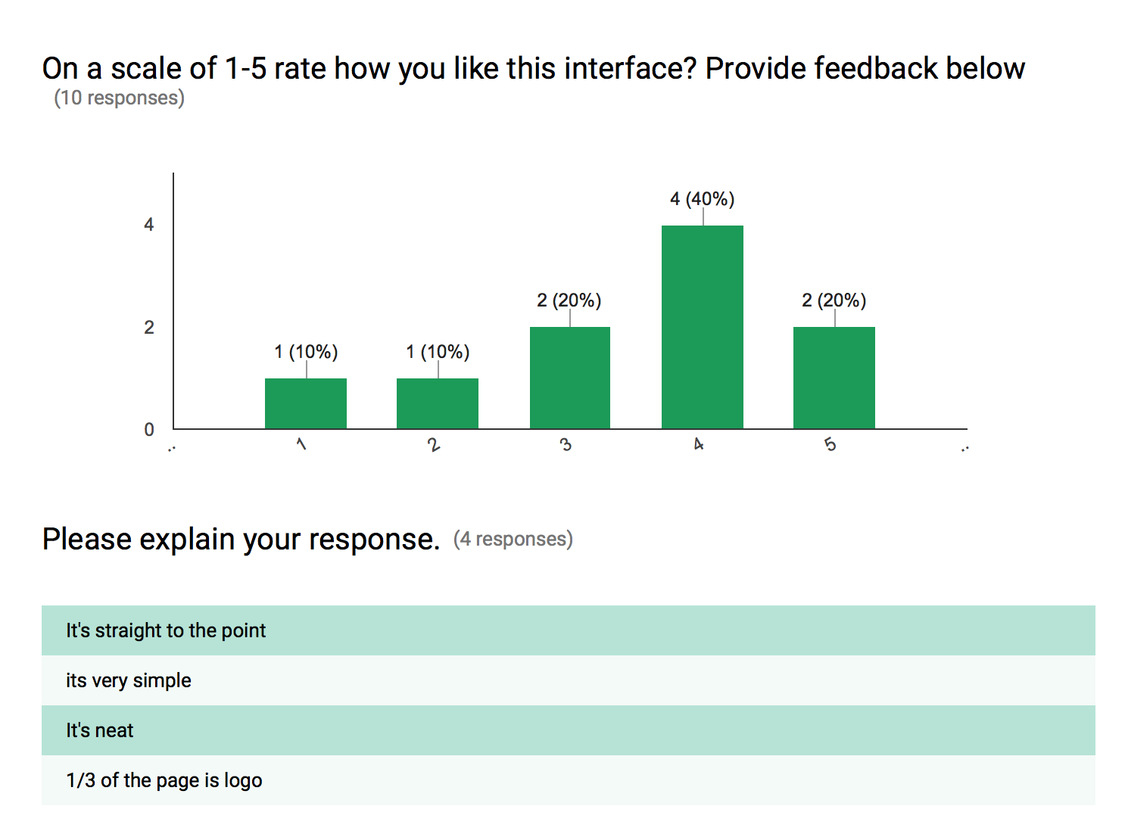
We received positive reviews on our interface with 60% of the respondents rating it as a 4 or 5. Given our user feedback, we edited the logo and improved the interface to provide clearer direction about where to click.

Slide 20
Additional Findings
When asked what aspects would make users more likely to engage, 67% of participants said badging or credentialing. 56% said reminders sent via email would help engagement. Shockingly, only 22% reported reminders sent via text as useful to engagement. 100% reported that the ability to respond with video and the ability to discuss with peers would be useful for video engagement.

Slide 21
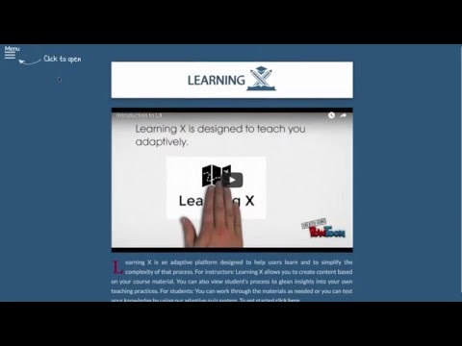
Demo
Project Website: http://learningx.abstractlogic.nyc
Student Demo
Demo video created by one of our users
Notes:
This demo video was created when one of our testers walked through the site for the first time. This is useful for seeing areas where the user paused or may have been confused about where to go. You can see after he took a quiz, he looked for directions about where to go next. One of our main goals for future work is to add more signposts within the actual quiz about the user’s progress and next steps.

Slide 22
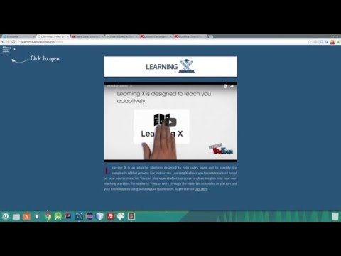
Demo
Instructor Demo
Notes:
In this slide we demonstrate the instructor functions of the system which includes adding a topic, adding resources to that topic, adding questions and viewing student’s progress

Slide 23
Design Reviews
PAR Review
Our design is up to PAR!
PERCEPTION: We designed the system interface minimalistically so that users can easily perceive functions. Because our system is adaptive, we design for all types of personalities. In the traditional classroom, perhaps the introverts of the room will be less likely to participate. Our persona, Sam, was a shy and reserved student so he required an adaptive online system that provides alternate ways of engaging. We also see the adaptive design of our system as an optimal way of mitigating boredom or monotony.
ATTENTION: The system adapts to the user’s capability and tries to meet them where they are in their learning trajectory. In this way, it does not overload the user. We believe that by having users access the system in a variety of environments, by ‘breaking set’, they will be encouraged to differently.
RETENTION: Our analytics show that since the site has been live, there have been 341 session among 35 visitors, which means that the 35 visitors have repeatedly visited the site and engaged with the materials.

Slide 24
Design Reviews
Simplicity Review
One of the most important rules of simplicity for our project is “Learn” because we rely on repetition for users to learn the material. That adaptive portion of the system is designed to repeat material that the user is not as knowledgeable in. We want to eliminate desperation by providing a "gentle", go-at-your-own pace learning system so the user will feel engaged. We hope this design will reduce anxiety of learning a new subject. We want the system to be very user friendly without being overly complicated. We want the user to feel comfortable and at ease when they are using the system that balances form and function. When learning a programming language, the user is often intimidated by an IDE if they have never seen one before. By teaching them coding principles in a non-traditional way (just opening up an IDE, following the assignment and coding) we feel we can make coding something fun to learn and not so intimidating.

Slide 25
Design Reviews
Accessibility Review
We tested the site using the following screen simulations for color blindness:
Monochromacy
Deuteranomaly
Protanomaly
Tritanomaly
While the colors of the site do change when someone with color blindness is viewing the site, the site still is legible and clear.
We added alt tags to the images on the site. Since there are few images we only needed a couple alt tags:
<img alt="Click Here to Start Arrow” src="imgs/clickhere2.png">
<img alt="Learning X Logo" src="imgs/1.png" height="30%" width="30%">

Slide 26
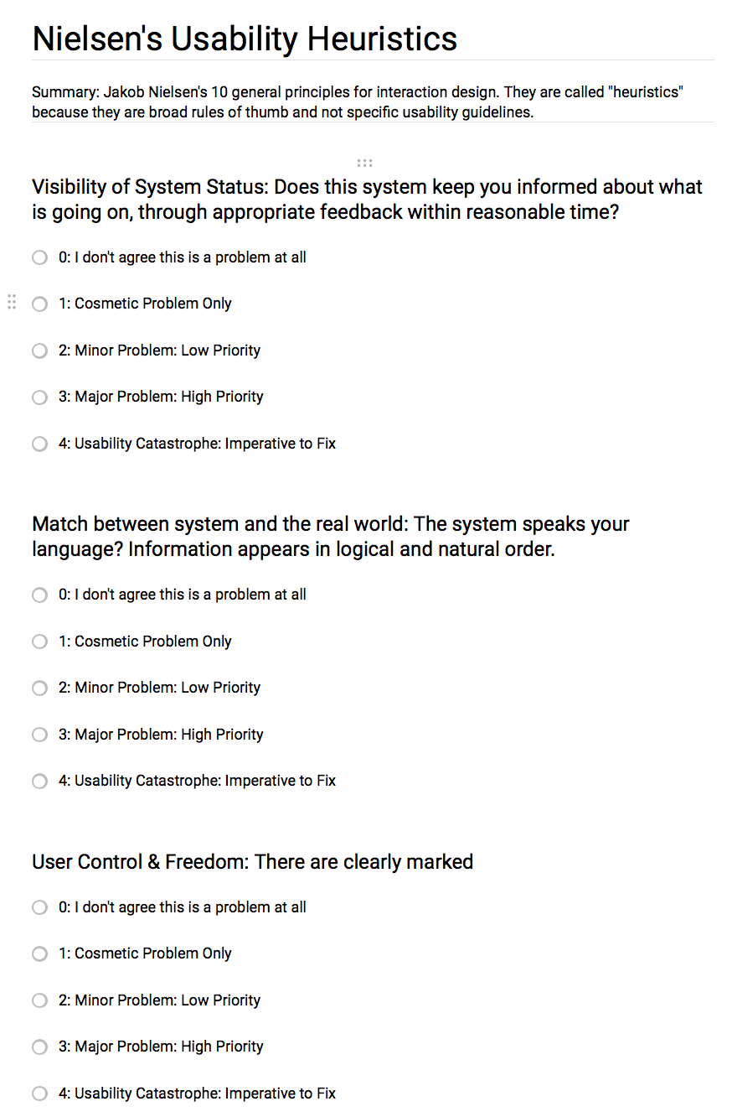
Design Reviews
Heuristic Review[1]
[1] Before conducting our heuristic evaluation, we chose Nielsen’s design heuristics.
[2] We could not embed the form into the presentation slides. If you click the first image, you can access the evaluation.
Notes:
We had users fill out this heuristic evaluation after walking through the site.

Slide 27
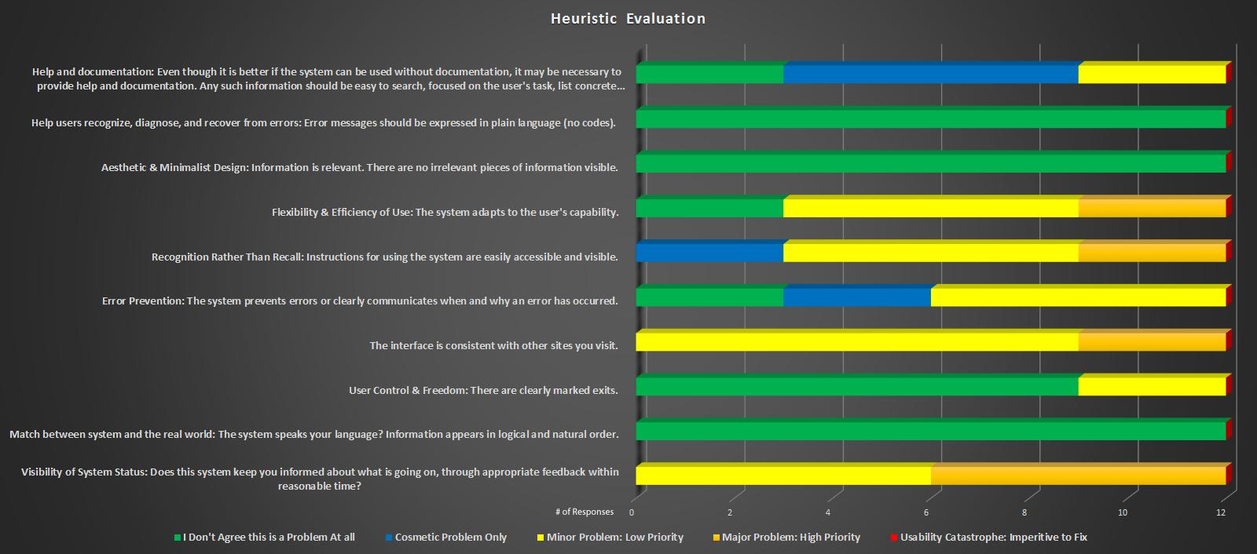
Design Reviews
Heuristic Evaluation Results
Notes:
In this slide, you can see the breakdown for the Heuristic review survey that users filled out: We had a total of 12 respondents. It’s good to note that none of the users stated there was a usability catastrophe in any of the categories(yay!). While some users did report Major problems with some of the categories there were no categories where the majority thought there were major problems. The highest number of major problems that users mentioned was the “Visibility of System Status” where we had a 50/50 split between it being a minor problem and a major problem. 3 of the 10 categories showed that users did not think it was a problem at all and those were “help users recognize, diagnose and recover from errors”, “Aesthetics & minimal design” and “Match between system and the real world”.

Slide 28
User Quotes
The “menu” button was not obvious. I watched the video twice and then it was only because I was convinced that I was missing something and went back to look for more.
When you watch a video and then move on to the questions, it says “awesome! You’ve already answered all the questions~” but it doesn’t give an immediate link to either go back to the video or to the next section. You have to go into the menu to do that.
The good news: The look is gorgeous. on the data types unit, you desperately need a table! Now, some bad news: You mis-spelled all the data types. Java is case sensitive, so it's int, float, char, etc. There are data types Integer, Float, Double, etc. but they are different and not at all what you mean here. Since the language is case sensitive you have got to get it right.
You can keep answering the same set of questions over and over to increase your percentage if you got one wrong on the first run. Not sure if that matters in the scope of UX design -- it might be more of a debugging issue.
The eclipse section has no question in its quiz, but the quiz button is still there. Also, you can start a quiz and then see a question and back out.
It’s a cool site, but you have too many calls to action on the homepage.
The site is responsive and looks great on mobile devices. The only issue appears in the quiz section. The questions that you can choose from are awkward to read.
The colors and font are easy to look at for extended periods of time. The lessons also are in a proper order.
Notes:
Quotes from our users! We received some fantastic feedback about next steps in our design process. Fortunately, many of the testers found the site to be easy to look at and engage with.

Slide 29
Design Reviews
Microinteractions
One of the main details that mattered to our testers was the feedback based on their progress through the system. For this reason, we added feedback for users on their progress as well as whether they got the question correct or not. Originally, we had designed the response to show up red if incorrect, but we found that this feedback was not salient enough. Our redesign includes more salient feedback on the user progress.
Originally, we used an invisible trigger for interaction with the menu. When users roll over the hamburger menu, the three lines move. However, we found that users were unsure where to go when they visited the site. As such, we added a “click to open” arrow pointing to the menu. This resolves the gulf of execution allowing the user to do what they want with an obvious place to click.
Another Microinteraction we took into consideration is when the user’s session times out and they try to access a page where they need to be logged in to view(i.e. user progress), the system will direct them to re-login and then sends them to the page they intended on navigating to. This prevents the user from having to re-navigate to the page they wanted to visit after re-logging in
Finally, we added the feedback “Heads Up! If you login in here, you can save your progress.” The user also always has access to the menu so they can easily exit.

Slide 30
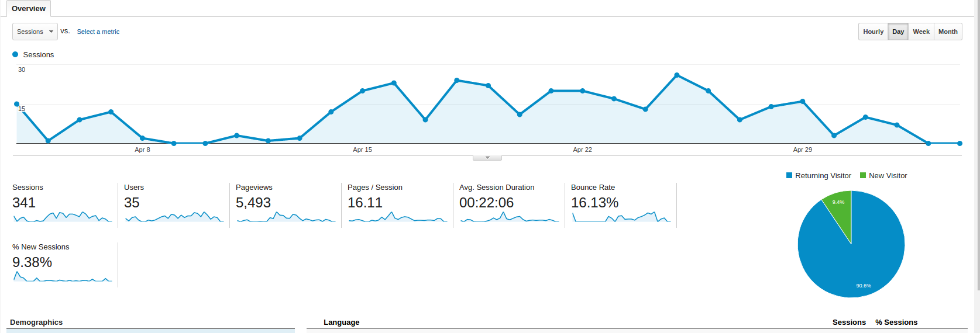
Design Reviews
Improving our ‘E’ - Engagement
We used Google Analytics to measure our Engagement.
You can see all of the analytics data by visiting the Google Analytics property: https://analytics.google.com/analytics/web/#report/visitors-overview/a55527113w113311352p118317766/ (only group members and the Professor have access to view the stats)
Notes:
As you can see from this slide we have had a total of 341 sessions with 35 users, 5,493 pageviews with an average of 16 page views per session. Our bounce rate is relatively low at 16.13% which is a good sign. The average session was about 22 minutes. While this is not bad we would love to see users spending at least an hour on the site on average. If we address the issues that users reported we believe this will greatly improve our E of Engagement. The chart also shows us Returning Vs New Users and we can see a majority of the users are returning users (90.6% vs 9.4%) so we feel that is also a good sign that the site is keeping them engaged enough to come back.

Slide 31
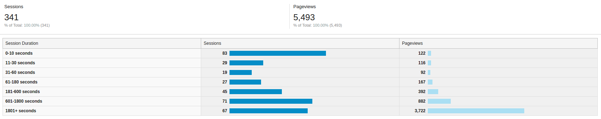
Design Reviews
Improving our ‘E’ - Engagement
Google Analytics Engagement Statistics.
Notes:
From this slide we can see out of the 341 sessions 67 of them spent more than 30 minutes on the site, 71 spent 10-30 minutes on the site and 83 only spent 0-10 seconds on the site. We should look into the reason why some people are only spending a minimal amount of time of the site and see if we can address the issues to insure they stay longer on the site. Doing this will also improve our E

Slide 32
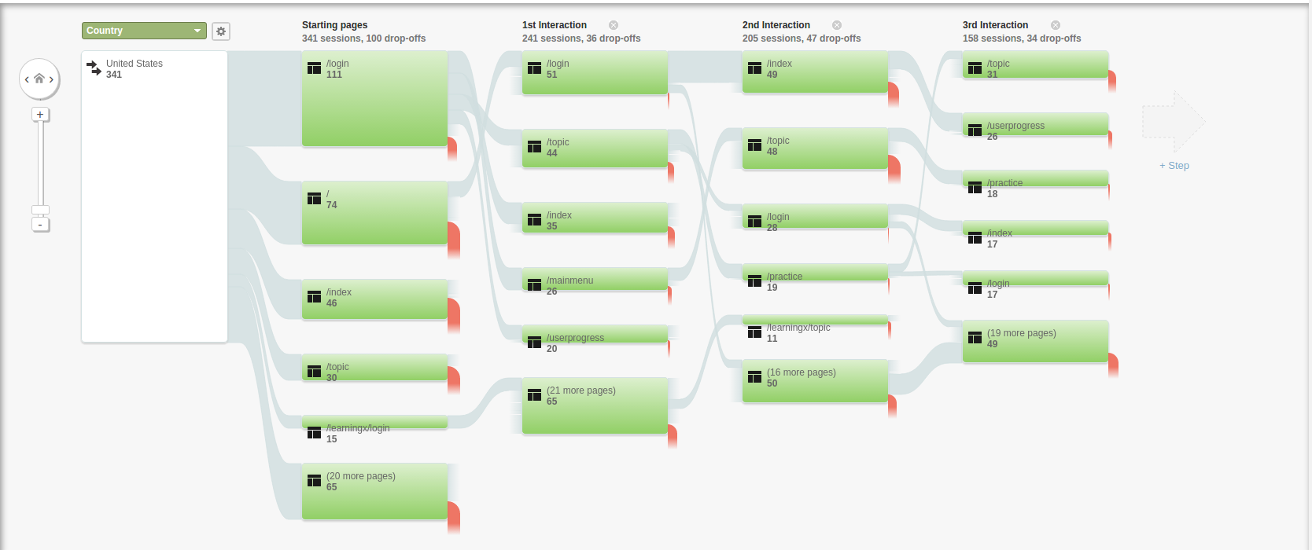
Design Reviews
User Flow
Notes:
This slide shows the user flow through the system. It shows which page they started on, which was their first, second and third interactions

Slide 33
Future Work: Design Recommendations
One of our main goals for future work is to work on the actual questions. In our user testing with a Java Programming professor, we found many flaws in our questions and the question bank was not as diverse as it should have been. While not a design issue, this impedes our ability to demonstrate, test, and iterate on the adaptability of the program. In a real world scenario the instructor would be responsible for loading the content into the system. We used pre-existing YouTube videos but ideally the instructor would post their own lectures, topic content, and questions.
Users also reported being confused about where to click on the homepage. There are three calls to action on the homepage: the video play button, the ‘click to open’ menu option, and the ‘click here’ link at the bottom of the description.
We also intend to monitor the most used languages of our users and translate the site for those top used languages. It is currently in English and Chinese.

